Slide 1

Adapting to Change: Nike's Journey to Greatness
From humble beginnings as a shoe company to becoming a global sports and lifestyle brand, Nike has consistently navigated the ever-evolving market, driven by innovation, brand-building, and a relentless pursuit of excellence.
By Fayis,Haroon,Mridhula,Mathews

Slide 2
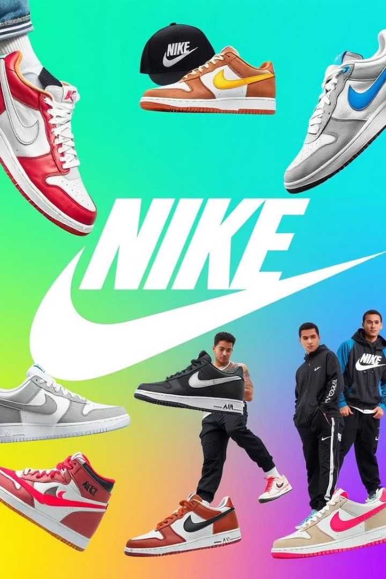
From Sneakers to Sports Apparel Empire
1
1964
Founded as Blue Ribbon Sports, selling athletic shoes out of the back of a car.
2
1971
Introduced the "Swoosh" logo and officially became Nike, Inc.
3
1978
Expanded into sportswear and apparel, launching the Nike Air technology.

Slide 3
Challenges of an Evolving Market
Intensifying Competition
Changing Consumer Preferences
Faced growing competition from other major athletic brands, requiring Nike to continuously innovate and differentiate its offerings.
Adapted to shifting consumer trends, such as the rise of athleisure and the growing demand for sustainable products.

Slide 4

Innovation and Product Development
1
Nike Air
2
Dri-FIT
3
Flyknit
Pioneered air-cushioned technology, providing unparalleled comfort and performance for athletes.
Developed moisture-wicking fabrics to keep athletes dry and comfortable during intense activities.
Introduced a revolutionary knitting process that created lightweight, breathable, and form-fitting footwear.

Slide 5

Building a Strong Brand Identity
Iconic Swoosh
Athlete Endorsements
The instantly recognizable Swoosh logo has become a symbol of athletic excellence and aspirational lifestyle.
Partnering with renowned athletes, such as Michael Jordan and Cristiano Ronaldo, to elevate the brand's prestige and appeal.
Storytelling
Crafting emotive narratives that inspire and connect with consumers, celebrating the spirit of athleticism and personal achievement.

Slide 6




Effective Marketing Strategies
Targeted Advertising
Leveraging powerful, visually compelling campaigns to reach and engage diverse consumer segments.
Digital Presence
Embracing the digital landscape, using social media and e-commerce platforms to amplify the brand's reach and engagement.
Experiential Marketing
Creating immersive brand experiences, such as flagship stores and athletic events, to foster deeper consumer connections.

Slide 7
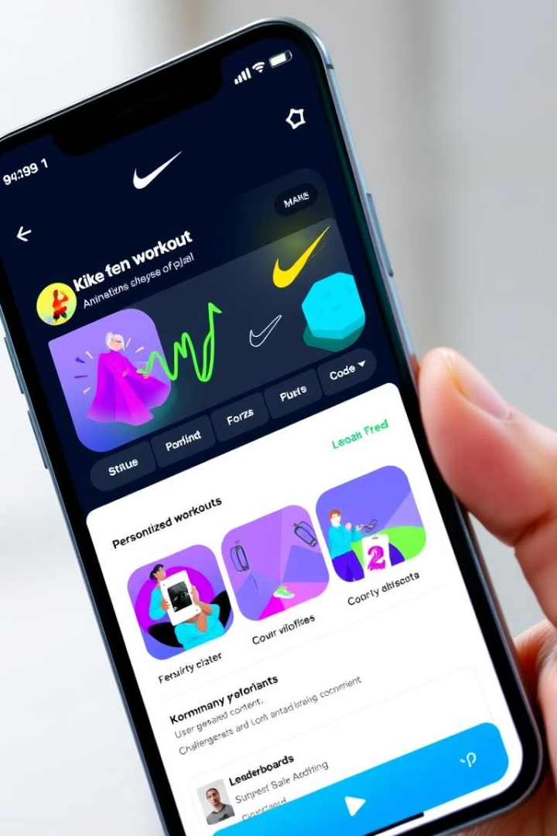
Embracing the Digital Revolution
1
E-commerce Expansion
Invested heavily in developing a robust e-commerce platform to reach consumers directly and provide a seamless online shopping experience.
2
Mobile App Innovation
Launched the Nike+ app, offering personalized training plans, product recommendations, and a connected community of athletes.
3
Data-Driven Insights
Leveraged data and analytics to better understand consumer behavior, optimize marketing strategies, and drive continuous improvement.

Slide 8



Sustainability and Corporate Social Responsibility
Sustainable Materials
1
Incorporated recycled and eco-friendly materials into product design, reducing the brand's environmental impact.
Renewable Energy
2
Transitioned to renewable energy sources in its operations, contributing to a more sustainable future.
Community Initiatives
3
Launched programs to support and empower underrepresented communities, fostering inclusivity and social impact.

Slide 9

Navigating Global Expansion
200+
Countries
Nike products are now available in over 200 countries, reaching a global audience.
75K
Employees
The brand has a workforce of over 75,000 employees, representing diverse backgrounds and expertise.
$46B
Revenue
Nike's annual revenue has grown to over $46 billion, solidifying its position as a global sports and lifestyle powerhouse.

Slide 10
Lessons Learned and Future Outlook
Adaptability
1
Nike's ability to evolve and adapt to changing market conditions has been key to its sustained success.
Innovation
2
Continuous investment in research, product development, and technological advancements has enabled Nike to stay ahead of the competition.
Brand Identity
3
Cultivating a strong, aspirational brand identity has allowed Nike to connect with consumers on an emotional level and solidify its position as a global leader.

Slide 11


